Slide 1

Introduction to communication
Its ways and process

Slide 2

What is communication
Communication refers to a two-way process of conveying ideas, thought, emotions , feeling etc. between two or more people through a medium to reach a common understanding.

Slide 3
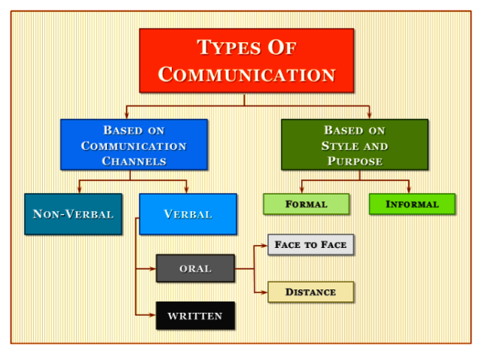
Types of Communication

Slide 4
Communication through channels/mediums
Mediums of communication-
1)Verbal medium – Through verbal medium we coney our ideas , thought or emotions through words or a common language. Example communication between you and your friends.
2)Non-verbal communication-Lets take an example that you are talking to your pet , here talking means that you are communicating with him without using words that mean you are using a non-verbal medium for your communication . In the ancient times also people used to communicate through several other non -verbal communication mediums. Earlier when king’s messenger had to gather people on the street , they used to play drums. Also in the earlier times when the people had to communicate for longer distances , they used to launch powerful rocket that was able to produce a high intensity light even during daytime which used to convey a particular meaning.
Sign languages are also non-verbal medium for communication
Also we communicate through body like giving hugs

Slide 5
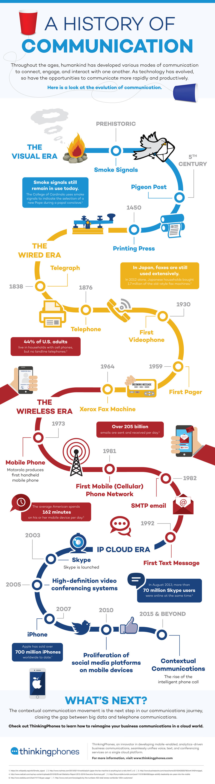
HISTORYOF COMMUNICATION
Let's look at the history of communication.

Slide 6
Process of Communication
Communication is the process of imparting or exchanging of information by speaking, writing or facial expression. Normally, it’s the act of transferring any information from one place, group or person to another . We communicate by that process known as communication process. It is the key feature organising any event , in management or doing any other thing.
We can divide the communication in different parts like-
1)Verbal
2)Non-verbal
3)Visuals
No matter which of the above methods we are using for communication, each one of them includes the following 8 steps or stages depending upon the given situation-

Slide 7

Stages of communication
There are mainly 8 steps in the communication, depending on the situation some may be excluded
1.Sender
2.Message
3.Encoding
4,Channel
5.Reciever
6.Decoding
7.Feedback
8.Noise

Slide 8
Stages or steps of communication
1. Sender-
The communicator generates the message and imparts it to the accepter. Sender is the first source of process in communication.
2. Message
It is the information, view, topics, idea, feelings, sensitivity etc. that is produced by the sender and is then planned to be communicated further.
3. Encoding
After generating message by the sender , it is encoded or Represented like for example as in the form of pictures, gestures, words etc. earlier it is being took.

Slide 9

4. Media or Channel
It is the middle part of the communication process. Basically, the message may be conveyed through writing. For communication also includes some important media like internet, telephone, e-mail, post, fax newspaper etc.
5. Receiver
It is the opposite end or person or party of communication. After, sending the written message then it’s encoding by the multiplexer via channel then come to receiver. Then, the receiver receives the message and sees it in proper outlook and acts to give reply to the message. Basically, the purpose of communication will be successful when message has been received the receiver.

Slide 10
6.Decoding
Decoding is the process of adapting the symbols encoded by the sender.
7. Feedback
When the receiver confirms to the sender message that he has received and understood it carefully, actually, the communication process is completely done. Then , the decoder gives a proper reply.
8. Noise
Noise is any type of disruption that interferes with the interpretation of information from the message sender. We can say it’s example bad telephone connection, faulty encoding, inattentive receiver, poor understanding of message, internet connection loading, due to prejudice etc.

